Slide 1
Optimization Techniques for ML (wrap-up)
CS771: Introduction to Machine Learning
Piyush Rai

Slide 2
Today
Some practical aspects for optimization for ML
Constrained optimization
Optimization of non-differentiable functions

Slide 3

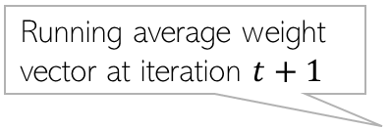
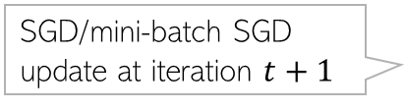
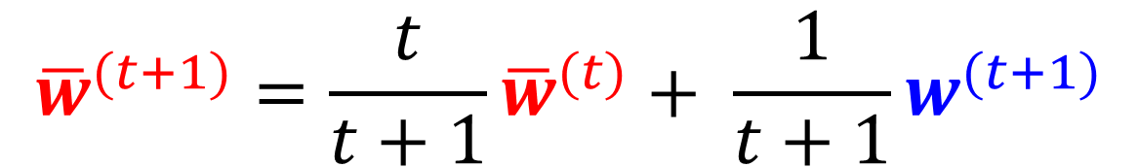

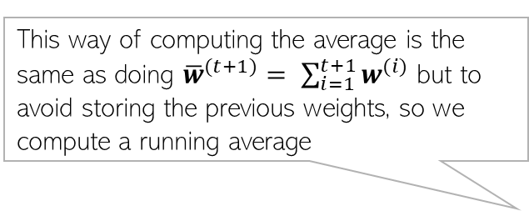

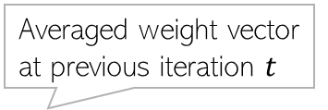
Some Practical Aspects: Iterate Averaging for SGD
SGD iterates $w^{(1)},w^{(2)},w^{(3)}, …$ can be noisy (recall SGD computes gradients using randomly picked single training example, or a small minibatch)
Polyak-Ruppert Averaging: Average SGD iterates and use the average in the end
Averaging is quite popular for SGD. Stochastic Weighted Averaging (SWA) is another such recently proposed scheme (similar to Polyak-Ruppert Averaging) used for deep neural networks
Stochastic gradient on a single/minibatch of examples
This way of computing the average is the same as doing ${\overline{w}}^{(t+1)}= \sum_{i=1}^{t+1}{w^{(i)}}$ but to avoid storing the previous weights, so we compute a running average
SGD/mini-batch SGD update at iteration $t+1$
$$w^{(t+1)}= w^{(t)}−η_{t}g^{(t)}$$
Averaged weight vector at previous iteration $t$
Sometimes, we don’t start averaging from iteration 1 but after some warm-up iterations
Running average weight vector at iteration $t+1$
$${\overline{w}}^{(t+1)}=\frac{t}{t+1}{\overline{w}}^{(t)}+ \frac{1}{t+1}w^{(t+1)}$$
Averaging Weights Leads to Wider Optima and Better Generalization (Izmailov et al, UAI 2018)

Slide 4
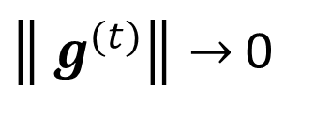



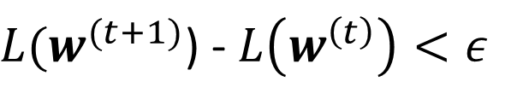
Some Practical Aspects: Assessing Convergence
Various ways to assess convergence, e.g. consider converged if
The objective’s value (on train set) ceases to change much across iterations
The parameter values cease to change much across iterations
Above condition is also equivalent to saying that the gradients are close to zero
The objective’s value has become small enough that we are happy with ☺
Use a validation set to assess if the model’s performance is acceptable (early stopping)
$L(w^{(t+1)}$) - $L\left(w^{\left(t\right)}\right)<ε$
(for some small pre-defined $ε$)
$\left\|{ w}^{(t+1)} −{ w}^{(t)}\right\|<τ$
(for some small pre-defined $τ$)
$\left\|{ g}^{(t)}\right\|→$0
Caution: May not yet be at the optima. Use at your own risk!

Slide 5
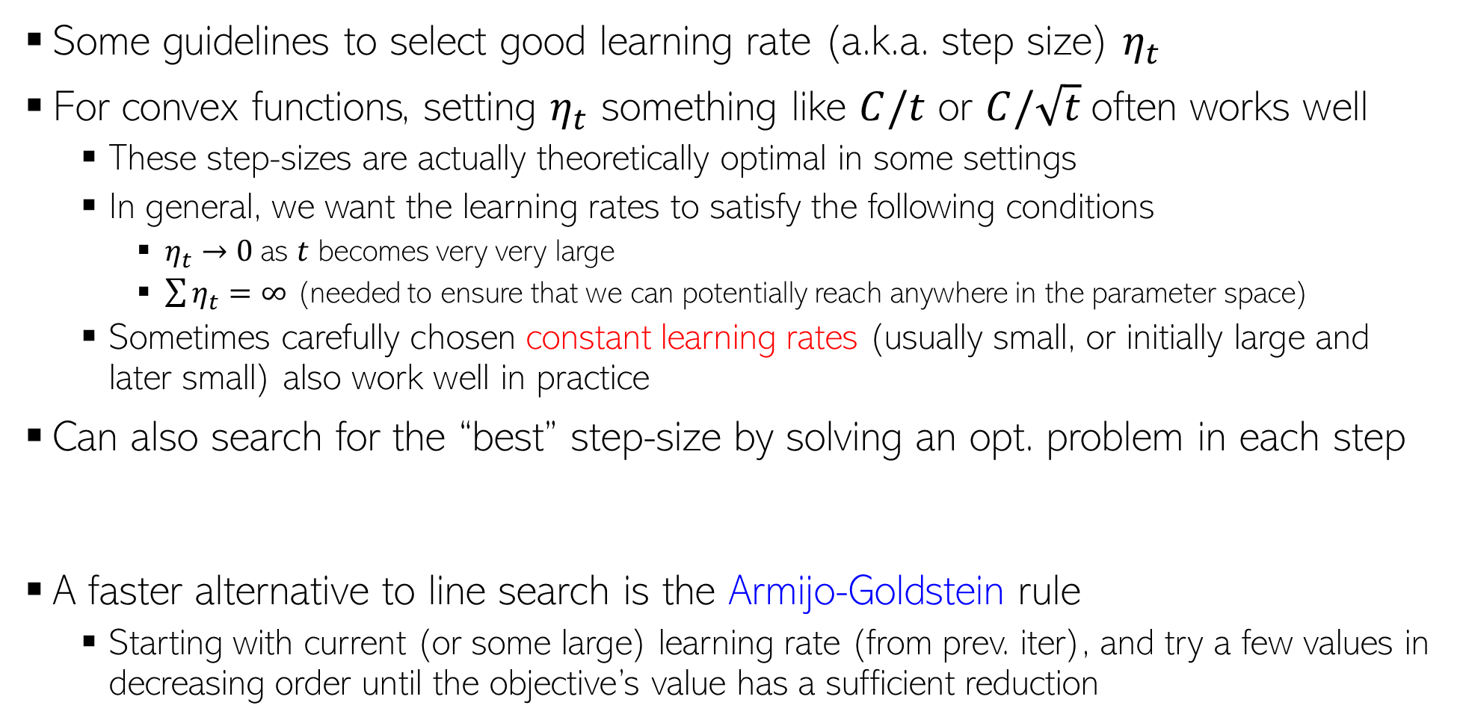
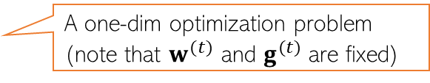
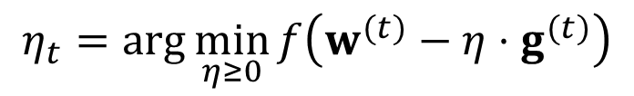
Some Practical Aspects: Learning Rate (Step Size)
Some guidelines to select good learning rate (a.k.a. step size) $η_{t}$
For convex functions, setting $η_{t}$ something like $C/t$ or $C/\sqrt{t}$often works well
These step-sizes are actually theoretically optimal in some settings
In general, we want the learning rates to satisfy the following conditions
$η_{t}→0$as $t$ becomes very very large
$\sum{η_{t}}=∞$ (needed to ensure that we can potentially reach anywhere in the parameter space)
Sometimes carefully chosen constant learning rates (usually small, or initially large and later small) also work well in practice
Can also search for the “best” step-size by solving an opt. problem in each step
A faster alternative to line search is the Armijo-Goldstein rule
Starting with current (or some large) learning rate (from prev. iter), and try a few values in decreasing order until the objective’s value has a sufficient reduction
C is a hyperparameter
Also called “line search”
$$η_{t}=\arg{\min_{η≥0}{f\left(w^{(t)}−η⋅g^{(t)}\right)}}$$
A one-dim optimization problem (note that $w^{(t)}$ and $g^{(t)}$ are fixed)

Slide 6
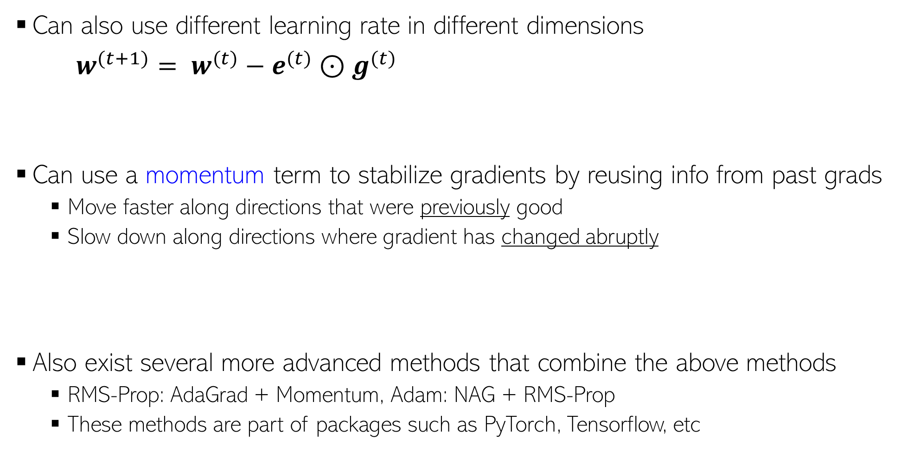
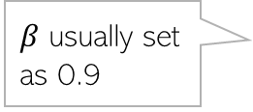


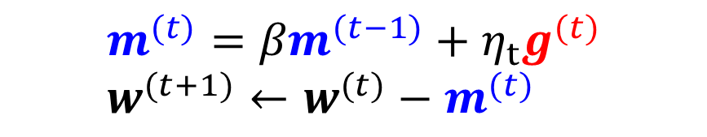
Some Practical Aspects: Adaptive Gradient Methods
If some dimension had big updates recently (marked by large gradient values), slow down along those directions by using smaller learning rates - AdaGrad
(Duchi et al, 2011)
Can also use different learning rate in different dimensions
$w^{(t+1)}= w^{(t)}−e^{(t)}{⊙g}^{(t)}$
Can use a momentum term to stabilize gradients by reusing info from past grads
Move faster along directions that were previously good
Slow down along directions where gradient has changed abruptly
Also exist several more advanced methods that combine the above methods
RMS-Prop: AdaGrad + Momentum, Adam: NAG + RMS-Prop
These methods are part of packages such as PyTorch, Tensorflow, etc
$$e_{d}^{(t)}= \frac{1}{\sqrt{ε+\sum_{τ=1}^{t}{{\left(g_{d}^{(t)}\right)}^{2}}}}$$
Vector of learning rates along each dimension
Element-wise product of two vectors
In an even faster version of this, $g^{(t)}$ is replaced by the gradient computed at the next step if previous direction were used, i.e., $∇L(w^{\left(t\right)}−{βm}^{(t−1)}$).
Called Nesterov’s Accelerated Gradient (NAG) method
The “momentum” term. Set to 0 at initialization
$$m^{(t)}={βm}^{(t−1)}+η_{t}g^{(t)} \\ w^{(t+1)}←w^{(t)}−m^{(t)}$$
$β$ usually set as 0.9

Slide 7
Constrained Optimization

Slide 8


Projected Gradient Descent
Consider an optimization problem of the form
Projected GD is very similar to GD with an extra projection step
Each iteration $t$ will be of the form
Perform update: $z^{(t+1)}= w^{(t)}−η_{t}g^{(t)}$
Check if $z^{(t+1)}$ satisfies constraints
If $z^{(t+1)}∈𝒞,$set $w^{(t+1)}$= $z^{(t+1)}$
If $z^{(t+1)}∉𝒞,$ project as $w^{(t+1)}$= $Π_{𝒞}[z^{(t+1)}]$
$w_{opt}= {arg min}_{w∈𝒞}$ $L(w)$
Projection
step
Projection operator

Slide 9
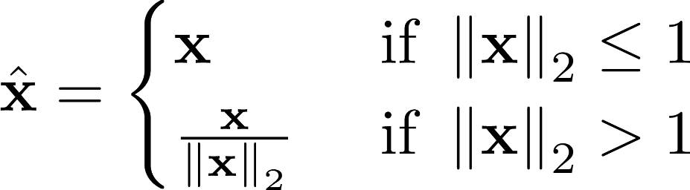
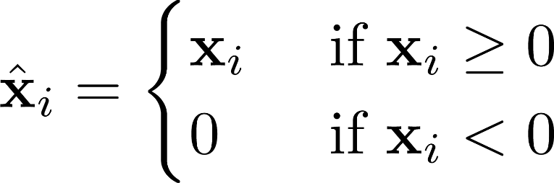



Projected GD: How to Project?
Here projecting a point means finding the “closest” point from the constraint set
For some sets $𝒞$, the projection step is easy
Another constrainted optimization problem! But simpler to solve! ☺
$Π_{𝒞}\left[z\right]={arg min}_{w∈𝒞}$ ${\left\|z−w\right\|}^{2}$
Projected GD commonly used only when the projection step is simple and efficient to compute
$𝒞$: Unit radius $ℓ_{2}$ball
$𝒞$: Set of non-negative reals
(0,1)
(1,0)
Projection = Normalize to unit Euclidean length vector
Projection = Set each negative entry in $z$ to be zero

Slide 10


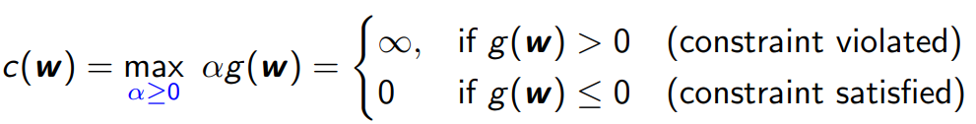
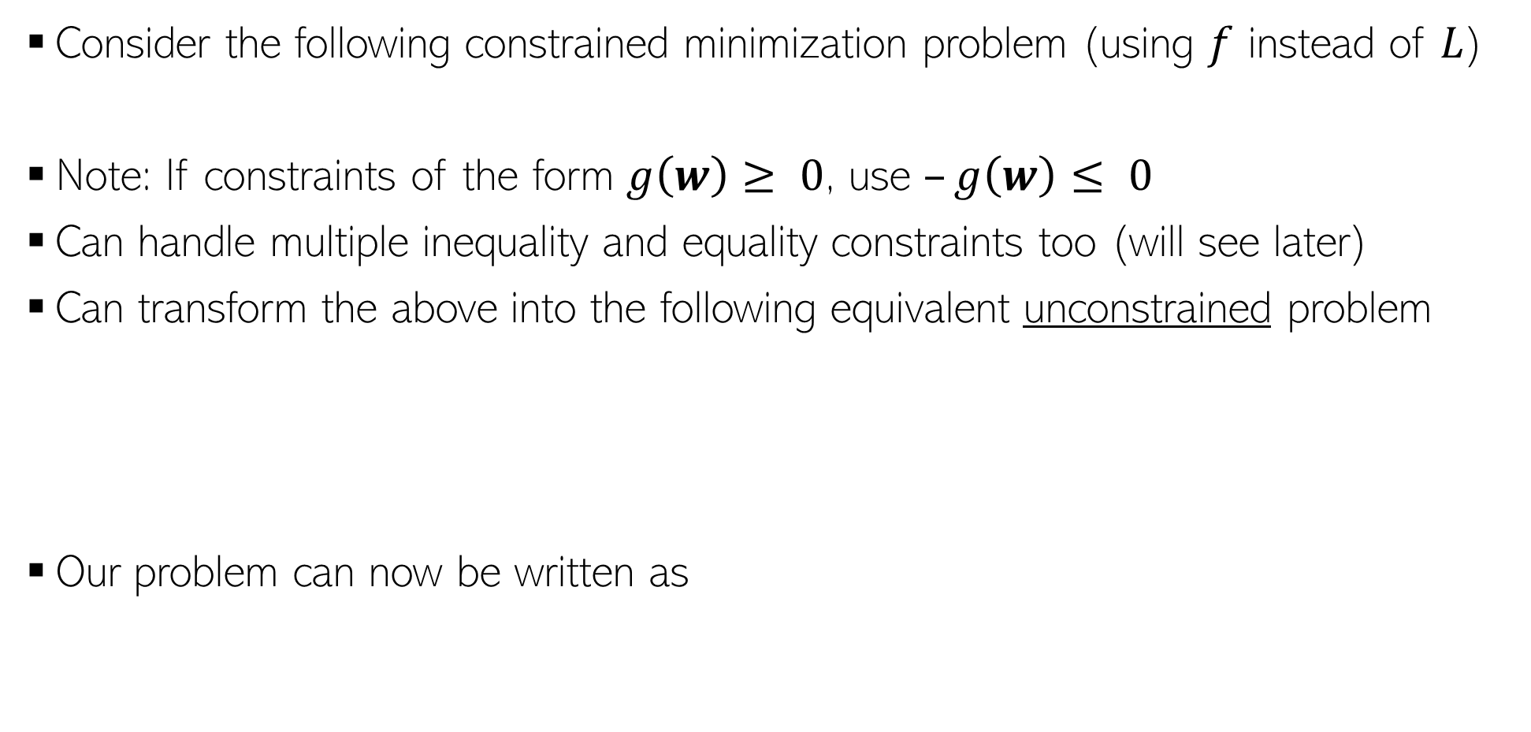
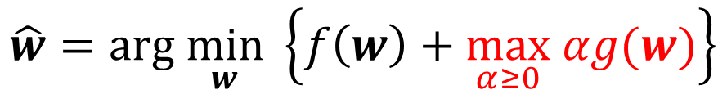
Constrained Opt. via Lagrangian
Consider the following constrained minimization problem (using $f$ instead of $L$)
Note: If constraints of the form $g\left(w\right)≥ 0$, use $–g\left(w\right)≤ 0$
Can handle multiple inequality and equality constraints too (will see later)
Can transform the above into the following equivalent unconstrained problem
Our problem can now be written as
$$\hat{w}=arg \min_{w} \left\{f\left(w\right)+\max_{α≥0} αg(w)\right\}$$

Slide 11

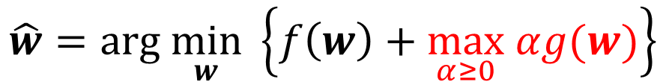

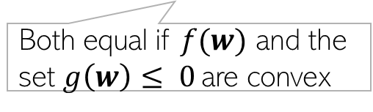
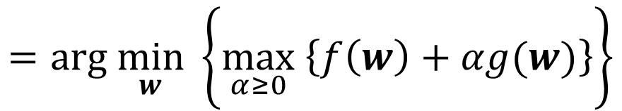
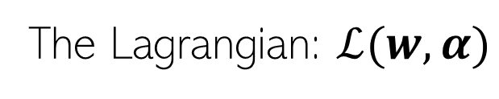
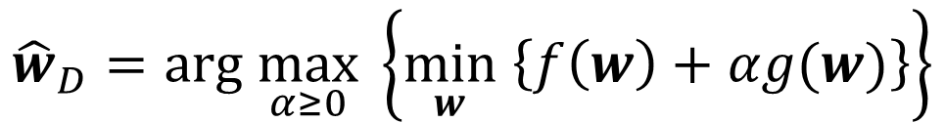
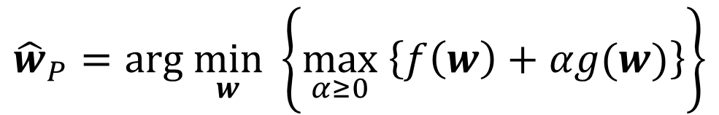
Constrained Opt. via Lagrangian
The Lagrangian: $ℒ(w,α)$
Therefore, we can write our original problem as
The Lagrangian is now optimized w.r.t. $w$ and $α$ (Lagrange multiplier)
We can define Primal and Dual problem as
$$=arg \min_{w} \left\{\max_{α≥0} \left\{f\left(w\right)+αg(w)\right\}\right\}$$
$$\hat{w}=arg \min_{w} \left\{f\left(w\right)+\max_{α≥0} αg(w)\right\}$$
$${\hat{w}}_{P}=arg \min_{w} \left\{\max_{α≥0} \left\{f\left(w\right)+αg(w)\right\}\right\}$$
(Primal Problem)
$${\hat{w}}_{D}=arg \max_{α≥0} \left\{\min_{w} \left\{f\left(w\right)+αg(w)\right\}\right\}$$
(Dual Problem)
Both equal if $f(w)$ and the set $g\left(w\right)≤ 0$are convex
complimentary slackness/Karush-Kuhn-Tucker (KKT) condition

Slide 12
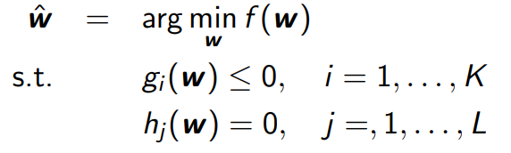

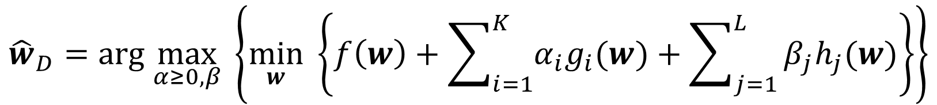
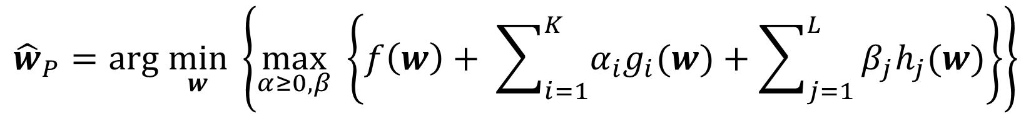
Constrained Opt. with Multiple Constraints
We can also have multiple inequality and equality constraints
Introduce Lagrange multipliers $α=[α_{1},α_{2},…,α_{K}]$ and $β=\left[β_{1},β_{2},…,β_{L}\right]$
The Lagrangian based primal and dual problems will be
$${\hat{w}}_{P}=arg \min_{w} \left\{\max_{α≥0,β} \left\{f\left(w\right)+ \sum_{i=1}^{K}{α_{i}g_{i}(w)}+\sum_{j=1}^{L}{β_{j}h_{j}(w)}\right\}\right\}$$
$${\hat{w}}_{D}=arg \max_{α≥0,β} \left\{\min_{w} \left\{f\left(w\right)+\sum_{i=1}^{K}{α_{i}g_{i}(w)}+\sum_{j=1}^{L}{β_{j}h_{j}(w)}\right\}\right\}$$

Slide 13
Optimization of Non-differentiable Functions

Slide 14






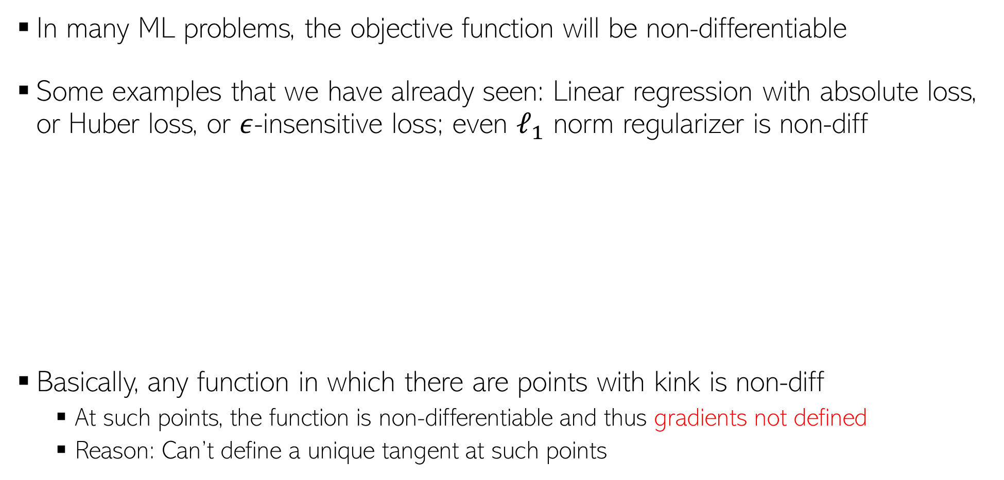



Dealing with Non-differentiable Functions
In many ML problems, the objective function will be non-differentiable
Some examples that we have already seen: Linear regression with absolute loss, or Huber loss, or $ε$-insensitive loss; even $ℓ_{1}$ norm regularizer is non-diff
Basically, any function in which there are points with kink is non-diff
At such points, the function is non-differentiable and thus gradients not defined
Reason: Can’t define a unique tangent at such points
Loss
$${|y}_{n}−f\left(x_{n}\right)|−ε$$
Loss
$${|y}_{n}−f\left(x_{n}\right)|$$
Loss
Not diff. here
Not diff. here
${y_{n}− f(x}_{n}$)
$$−δ$$
$$δ$$
${y_{n}− f(x}_{n}$)
$$−ε$$
$$ε$$
${y_{n}− f(x}_{n}$)
Not diff. here
Not diff. here
Not diff. here

Slide 15
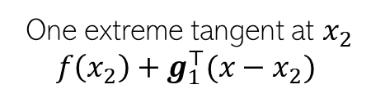


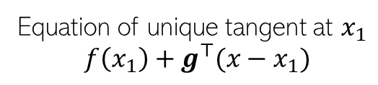


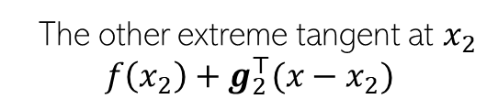
Sub-gradients
For convex non-diff fn, can define sub-gradients at point(s) of non-differentiabilty
For a convex, non-diff function $f(x)$, sub-gradient at$x_{∗}$is any vector $g$ s.t. $∀x$
$$f\left(x\right)$$
Convex, thus lies above all its tangents
Equation of unique tangent at $x_{1}$
$$f\left(x_{1}\right)+g^{⊤}(x−x_{1})$$
differentiable
here
One extreme tangent at $x_{2}$
$$f\left(x_{2}\right)+g_{1}^{⊤}(x−x_{2})$$
non-differentiable
here
Region containing all sub-gradients
The other extreme tangent at $x_{2}$
$$f\left(x_{2}\right)+g_{2}^{⊤}(x−x_{2})$$
$$x_{1}$$
$$x_{2}$$
$$f\left(x\right)≥f\left(x_{∗}\right)+ g^{⊤}(x−x_{∗})$$

Slide 16
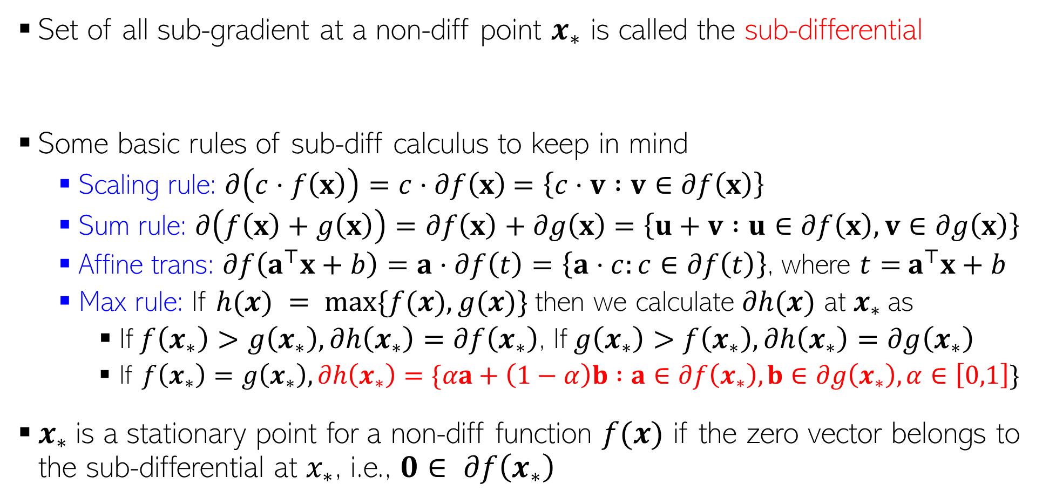
Sub-gradients, Sub-differential, and Some Rules
Set of all sub-gradient at a non-diff point $x_{∗}$ is called the sub-differential
Some basic rules of sub-diff calculus to keep in mind
Scaling rule: $∂\left(c⋅f\left(x\right)\right)=c⋅∂f\left(x\right)$ $=\left\{c⋅v :v∈∂f\left(x\right)\right\}$
Sum rule: $∂\left(f\left(x\right)+g\left(x\right)\right)=∂f\left(x\right)+∂g\left(x\right)$ $=\left\{u+v :u∈∂f\left(x\right),v∈∂g\left(x\right)\right\}$
Affine trans: $∂f\left(a^{⊤}x+b\right)=a⋅∂f\left(t\right)=\left\{a⋅c:c∈∂f\left(t\right)\right\}$, where $t=$ $a^{⊤}x+b$
Max rule: If $h(x) = max⁡\{f(x),g(x)\}$then we calculate $∂h(x)$ at $x_{∗}$as
If $f\left(x_{∗}\right)>g\left(x_{∗}\right),∂h\left(x_{∗}\right)=∂f\left(x_{∗}\right)$, If $g\left(x_{∗}\right)>f\left(x_{∗}\right),∂h\left(x_{∗}\right)=∂g\left(x_{∗}\right)$
If $f\left(x_{∗}\right)=g\left(x_{∗}\right), ∂h\left(x_{∗}\right)=\{αa+\left(1−α\right)b :a∈∂f\left(x_{∗}\right),b∈∂g\left(x_{∗}\right),α∈\left[0,1\right]\}$
$x_{∗}$is a stationary point for a non-diff function $f(x)$ if the zero vector belongs to the sub-differential at $x_{∗}$, i.e., $0∈ ∂f\left(x_{∗}\right)$
$$∂f\left(x_{∗}\right)≜\left\{g :f\left(x\right)≥{f\left(x_{∗}\right)+g}^{⊤}\left(x−x_{∗}\right) ∀x\right\}$$
The affine transform rule is a special case of the more general chain rule

Slide 17

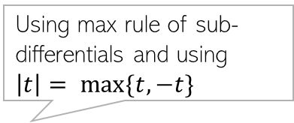
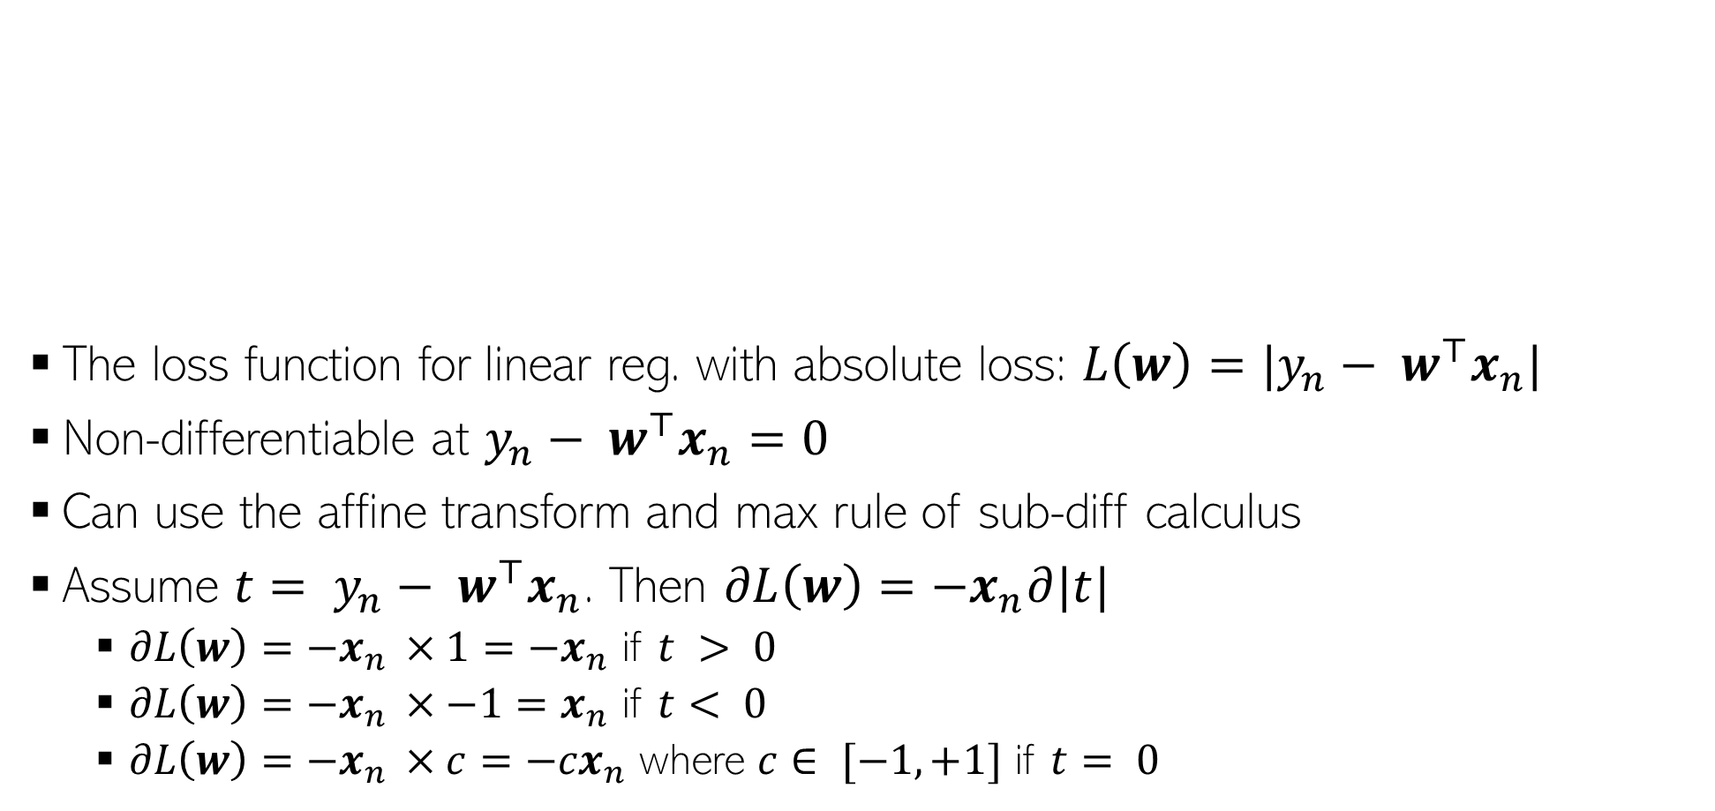

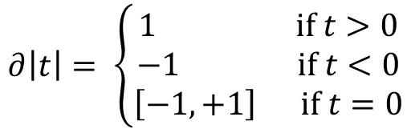




Sub-Gradient For Absolute Loss Regression
Using max rule of sub-differentials and using $\left|t\right|= max\{t,−t\}$
$$|y_{n}− w^{⊤}x_{n}|$$
The loss function for linear reg. with absolute loss: $L\left(w\right)=|y_{n}− w^{⊤}x_{n}|$
Non-differentiable at $y_{n}− w^{⊤}x_{n}=0$
Can use the affine transform and max rule of sub-diff calculus
Assume ${t= y}_{n}− w^{⊤}x_{n}$. Then $∂L\left(w\right)=−x_{n}∂|t|$
$∂L\left(w\right)=−x_{n }×1=−x_{n}$ if $t > 0$
$∂L\left(w\right)=−x_{n }×−1=x_{n}$ if $t< 0$
$∂L\left(w\right)=−x_{n }×c=−{cx}_{n}$ where $c∈ [−1,+1]$ if $t= 0$
$$|t|$$
$∂\left|t\right|= \left\{\begin{aligned}1 if t>0 \\ −1 if t<0 \\ \left[−1,+1\right] if t=0\end{aligned}\right.$
$$0$$
$$y_{n}− w^{⊤}x_{n}$$
$$0$$
$$t$$

Slide 18



Sub-Gradient Descent
Suppose we have a non-differentiable function $L(w)$
Sub-gradient descent is almost identical to GD except we use subgradients
Sub-Gradient Descent
Initialize $w$ as $w^{(0)}$
For iteration $t=0,1,2,…$(or until convergence)
Calculate the sub-gradient $g^{(t)}∈∂L(w^{(t)})$
Set the learning rate $η_{t}$
Move in the opposite direction of subgradient
$$w^{(t+1)}= w^{(t)}−η_{t}g^{(t)}$$

Slide 19
Optimization for ML: Some Final Comments
Gradient methods are simple to understand and implement
More sophisticated optimization methods also often use gradient methods
Backpropagation algo used in deep neural nets is GD + chain rule of differentiation
Use subgradient methods if function not differentiable
Constrained optimization can use Lagrangian or projected GD
Second order methods such as Newton’s method faster but computationally expensive
But computing all this gradient related stuff by hand looks scary to me. Any help?
Don’t worry. Automatic Differentiation (AD) methods available now (will see them later)
AD only requires specifying the loss function (especially useful for deep neural nets)
Many packages such as Tensorflow, PyTorch, etc. provide AD support
But having a good understanding of optimization is still helpful

